Slide 1

Presentation On Python Programming language on Life Expectancy Presented by Sajith Vellappillil Under the guidance of Mr. Vijay Kumar

Slide 2
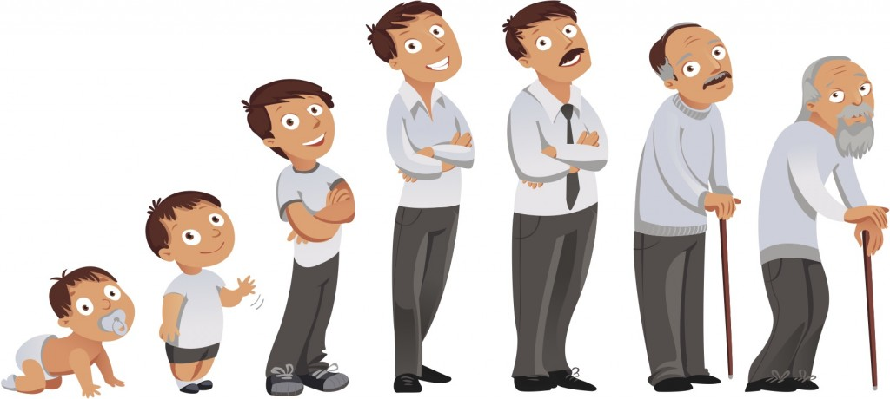
Introduction
Dataset:Human Life Expectancy
Source: Kaggle
Life expectancy is a statistical measure of the average time a human is expected to live, based on the year of birth, current age, and other demographic factors including biological sex.

Slide 3
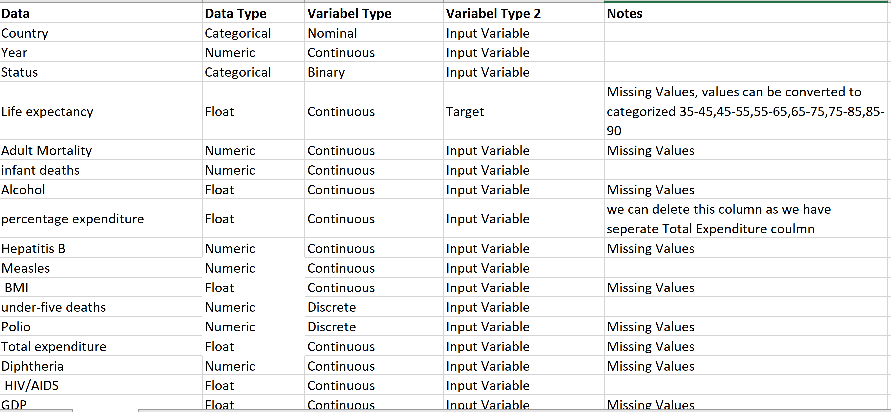
Dataset - Variables

Slide 4
UNDERSTANDING THE PROBLEM
The dataset has life expectancy for each country for each year and includes other information that may or may not be correlated to life expectancy of a country.
Our goal is to understand:
What is the impact of schooling on the lifespan of humans?
Does Life Expectancy have positive or negative relationship with drinking alcohol?
Does immunization help increase the life expectancy?
How does Infant and Adult mortality rates affect life expectancy?
Does income composition affect life expectancy?
UNDERSTANDING THE DATA
We need to understand the data and decide which variables are related to our target and provide us with valuable result for decision-making.
For this, we would ready our dataset for performing analysis by
→Data Wrangling -- Reading / Import libraries / Check for issues / Clean the data

Slide 5
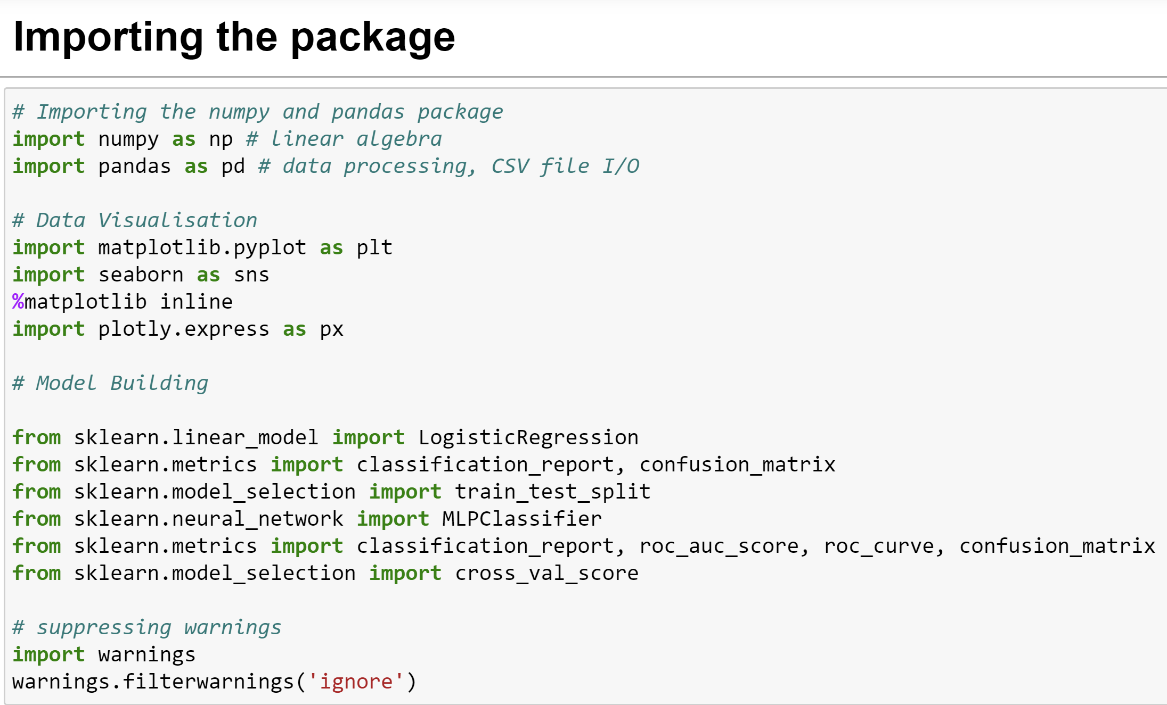
Libraries

Slide 6
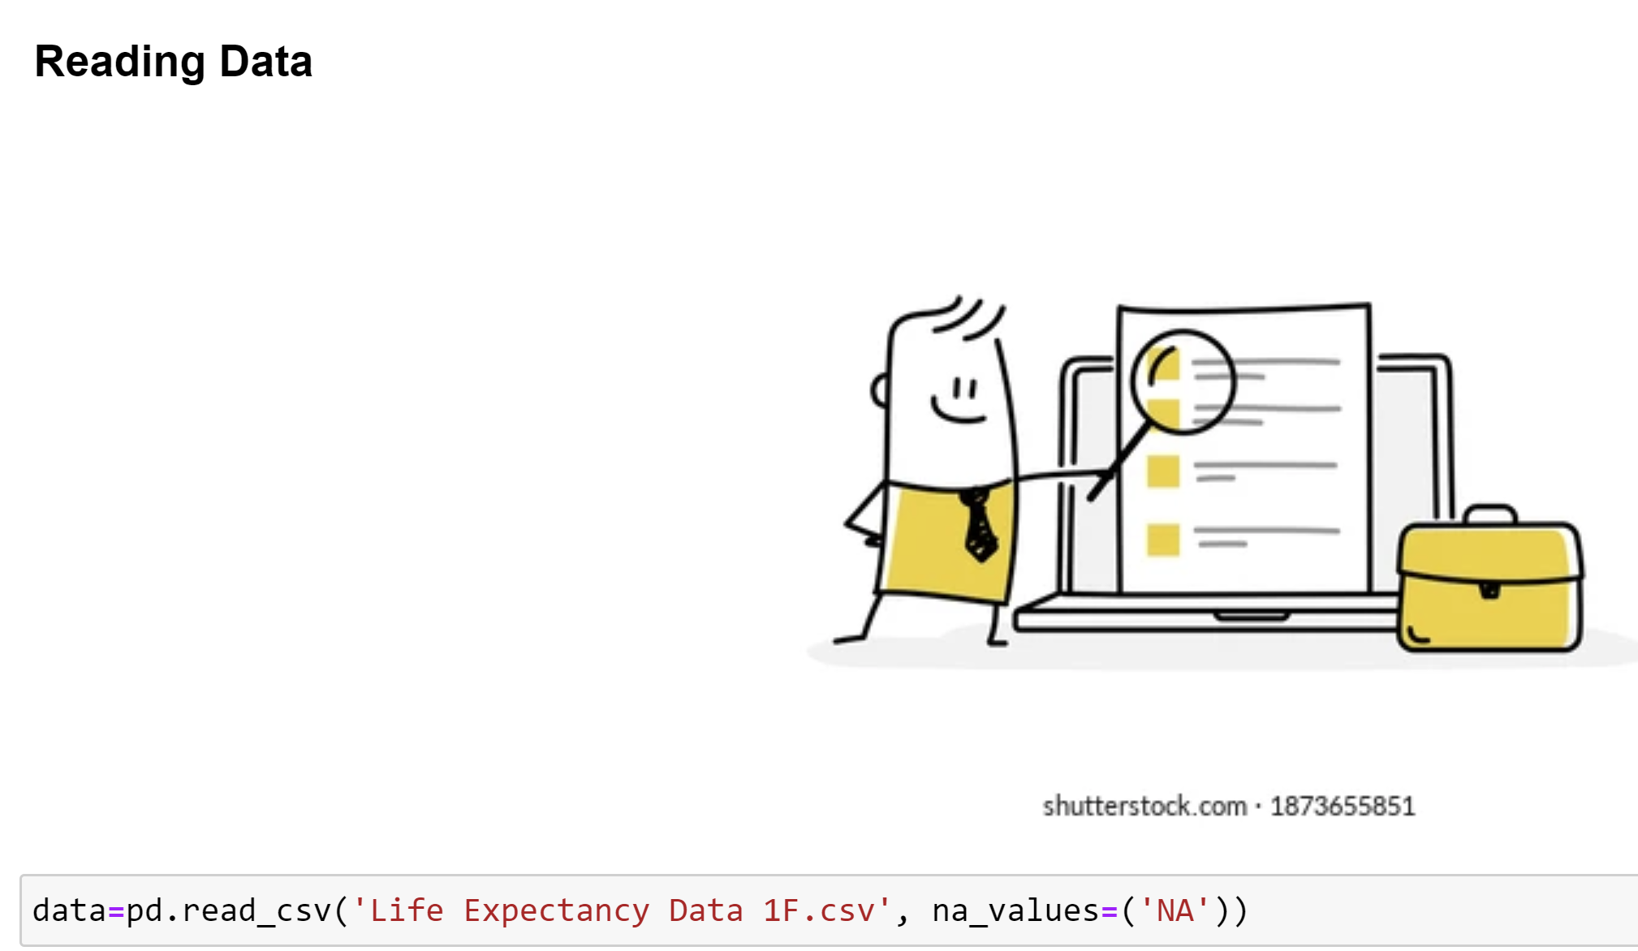

Slide 7


Slide 8
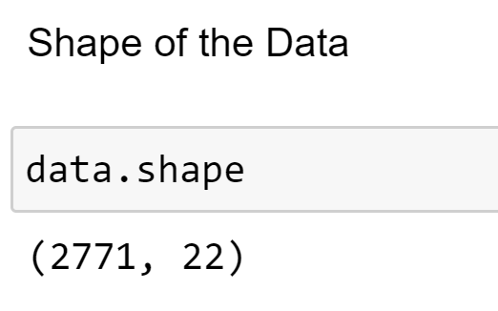
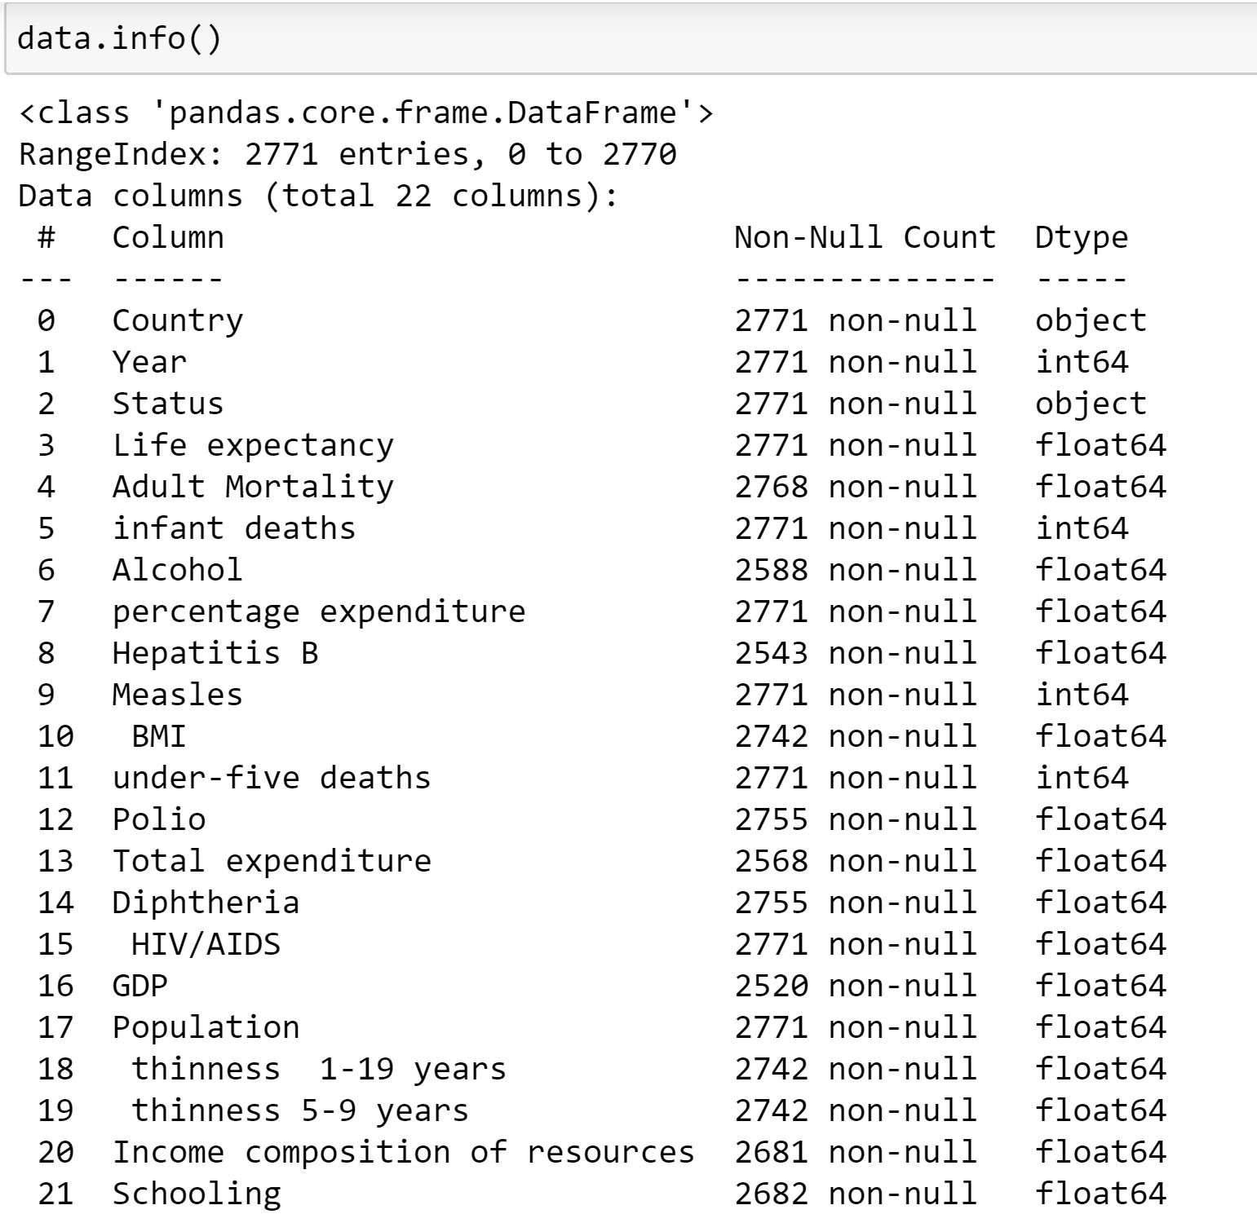
Here we see that there are only 2 categorical variables – Country and Status
Not null variables
--Adult Mortality
--Alcohol
--Hepatitis B
--BMI
--Total Expenditure
--Diphtheria
--GDP
--Thinness 1-19 years
--Thinness 5-9 years
--Income Composition
--Schooling

Slide 9
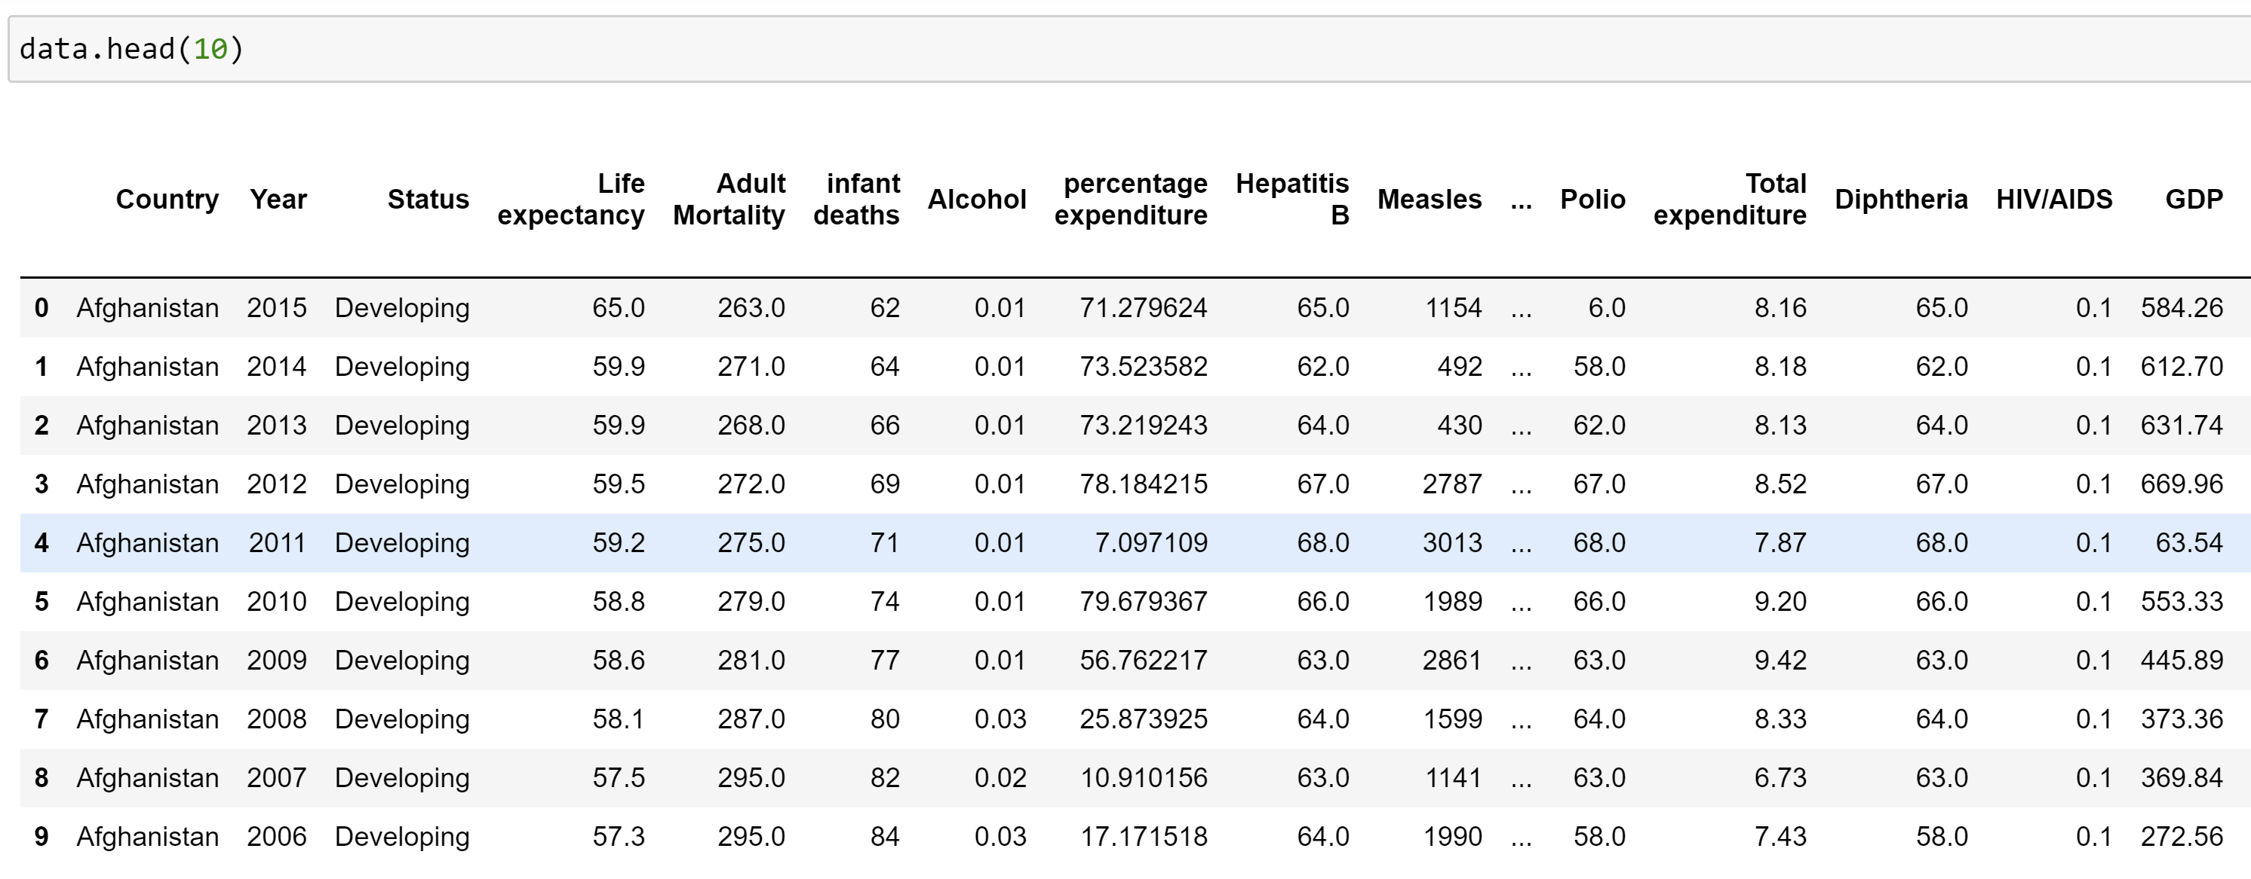
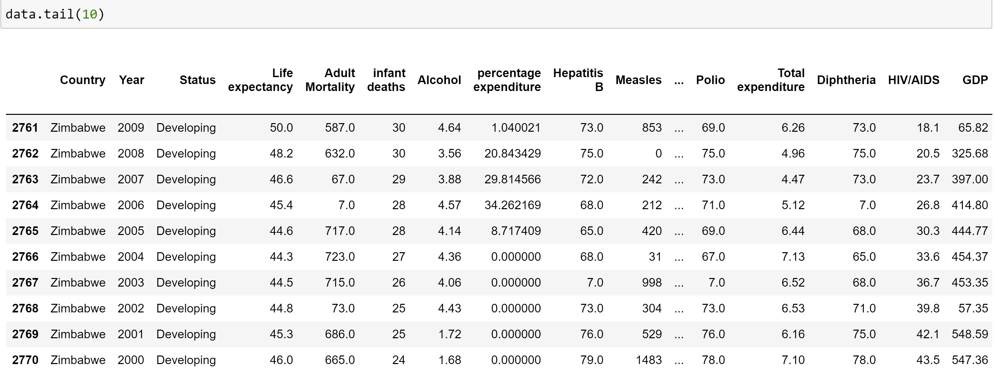
Checking the Head and Tail of the data – First and last 10 obs

Slide 10
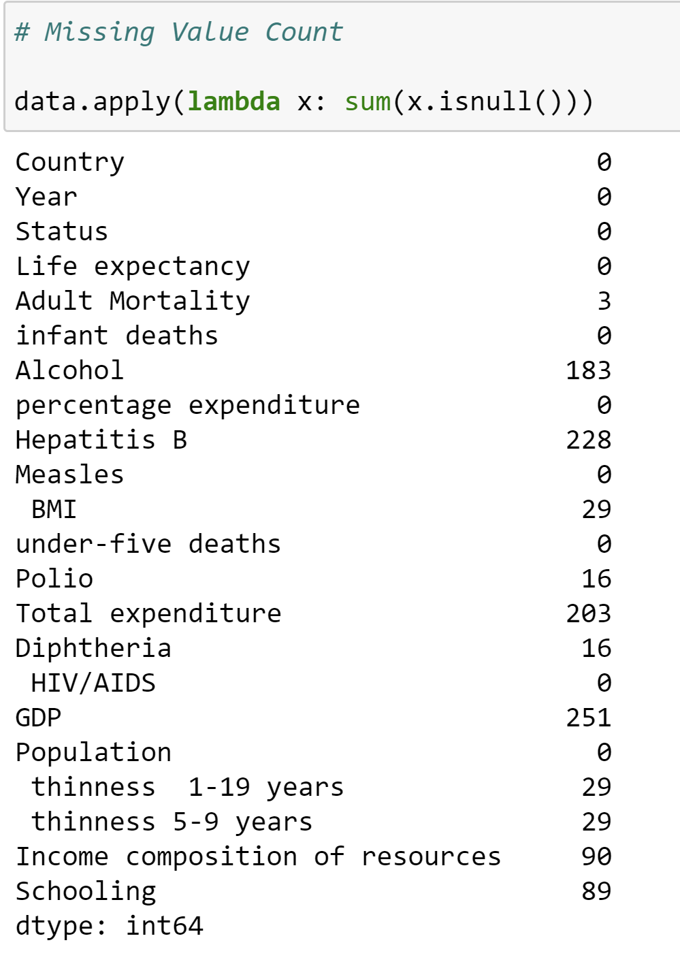
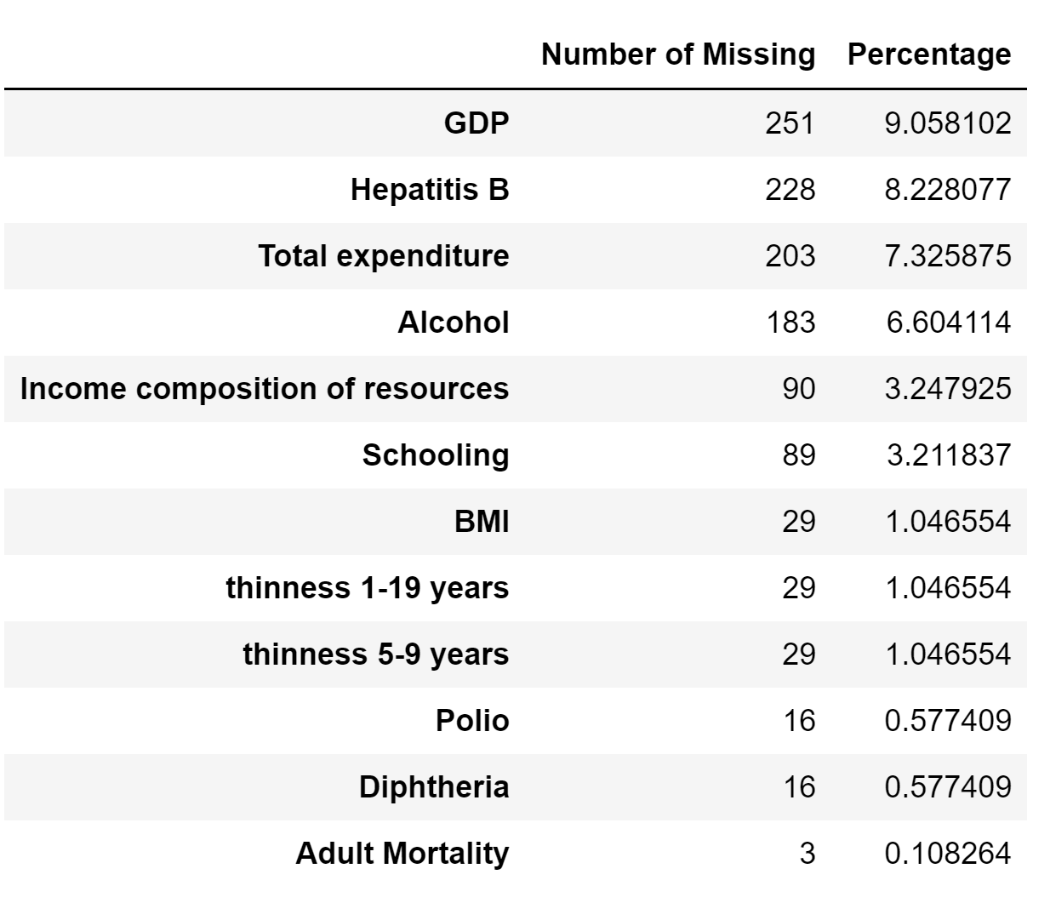
Checking the missing values

Slide 11


Slide 12
Exploratory Data Analysis (EDA)
Exploratory Data Analysis (EDA) is an approach/philosophy for data analysis that employs a variety of techniques (mostly graphical) to maximize insight into a data set;
uncover underlying structure;
extract important variables;
detect outliers and anomalies;
test underlying assumptions;
develop parsimonious models; and
determine optimal factor settings.

Slide 13
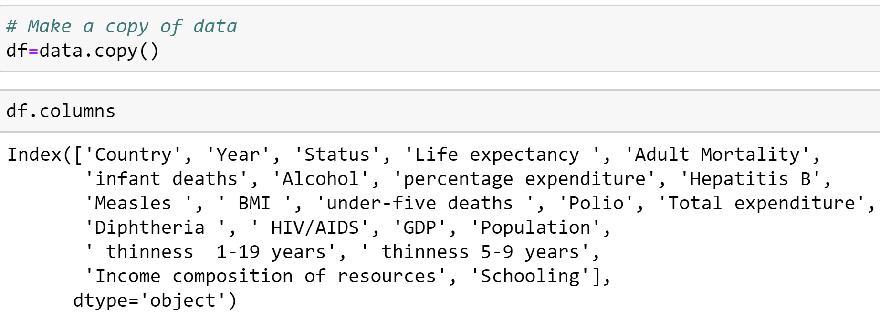
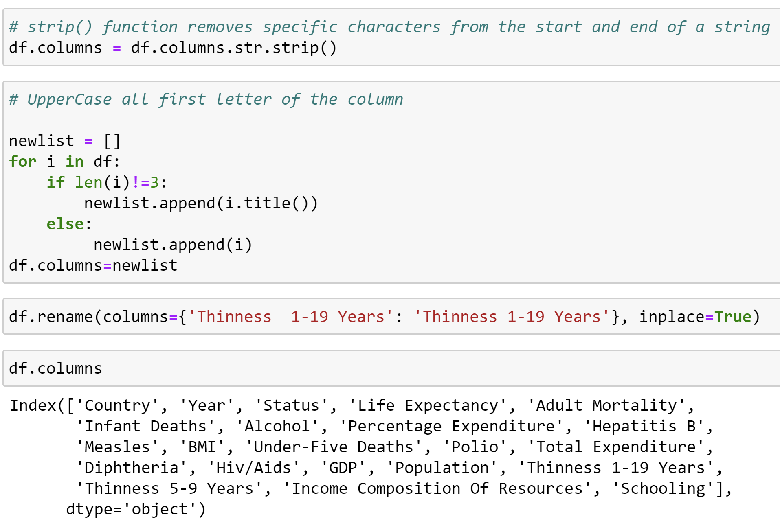
Making a copy of the data for our analysis
Using strip() function to remove specific characters from start and end of a string

Slide 14
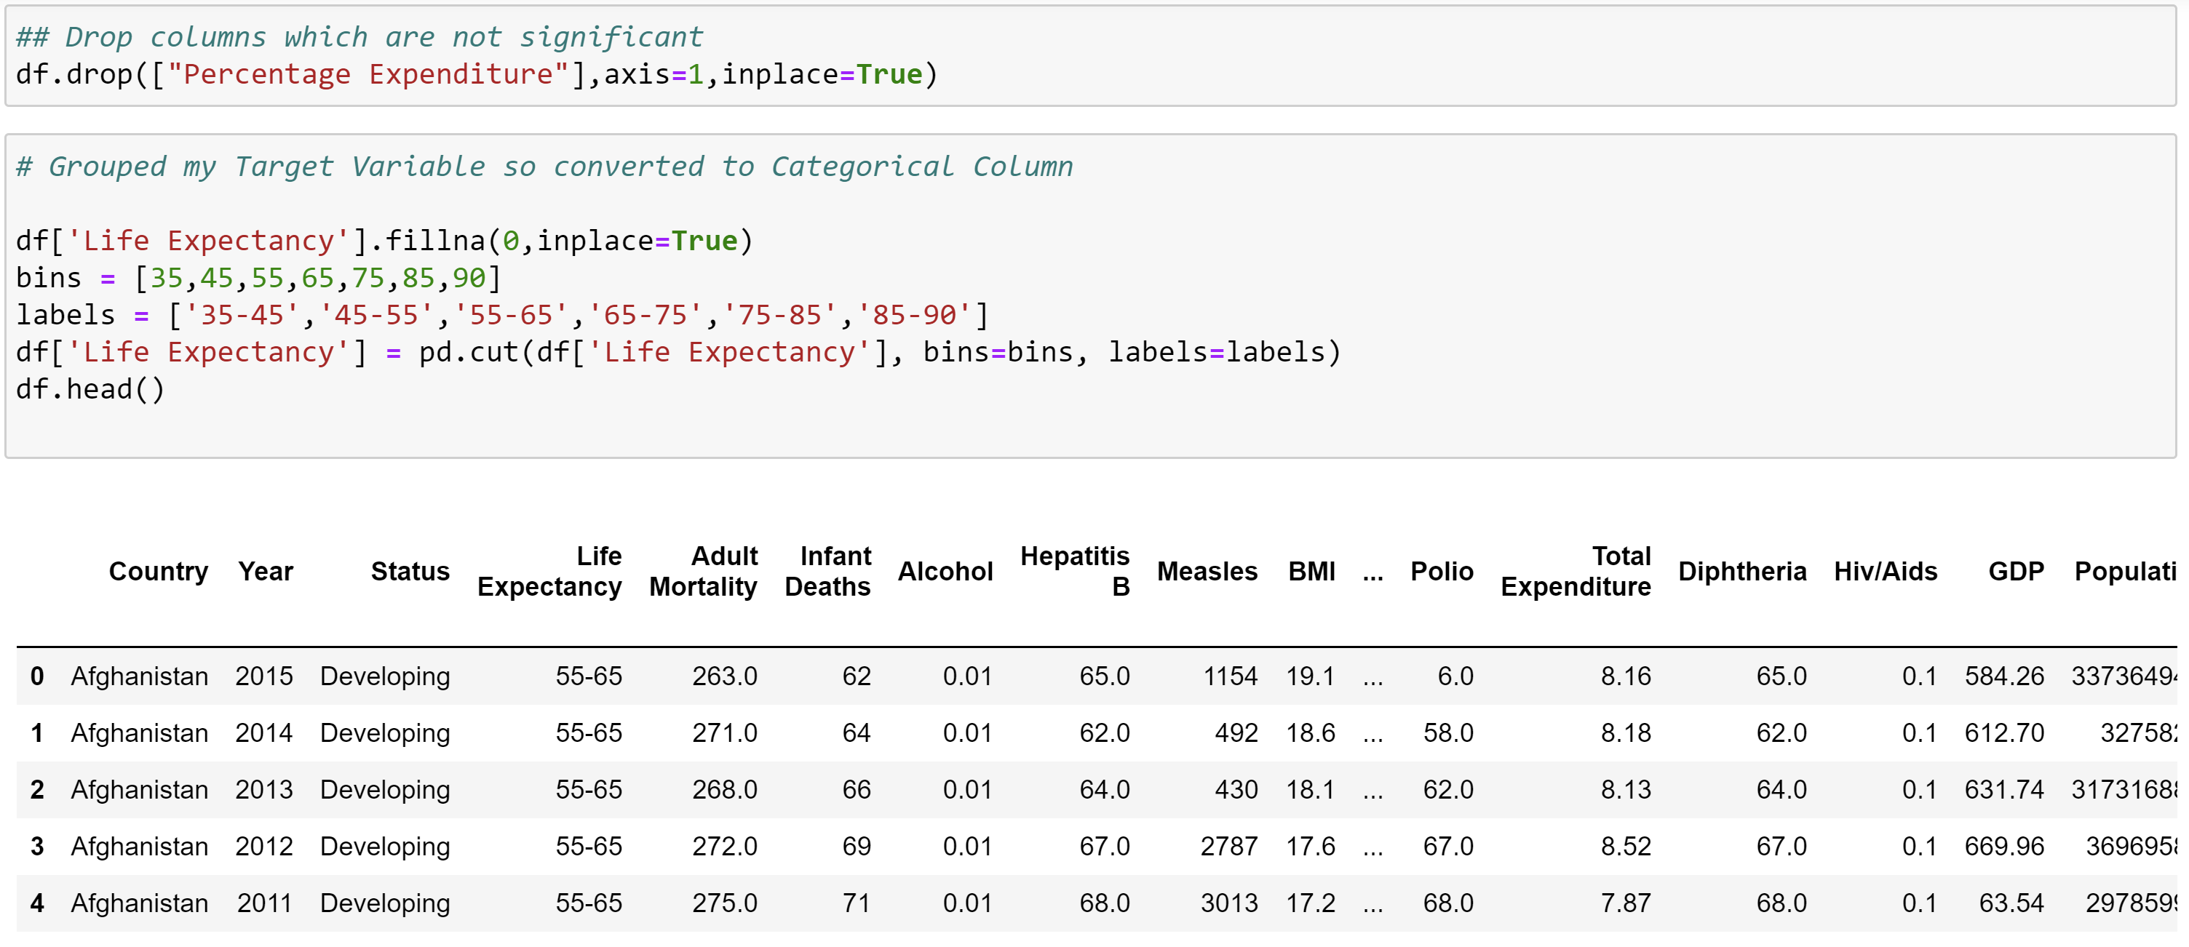
Dropping unwanted columns and Converting target variable ‘Life Expectancy’ to categorical Column for segmentation

Slide 15
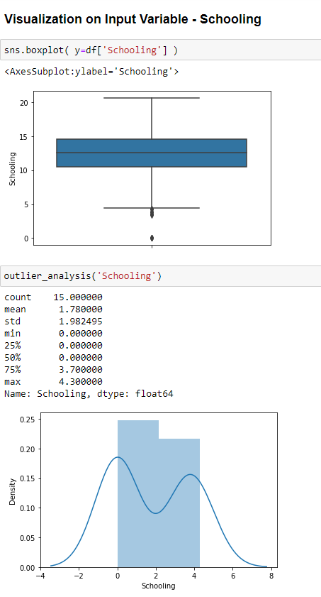
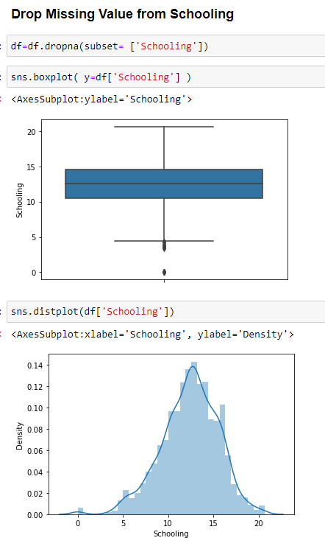
UNIVARIATE ANAYSIS
Handling Missing values

Slide 16
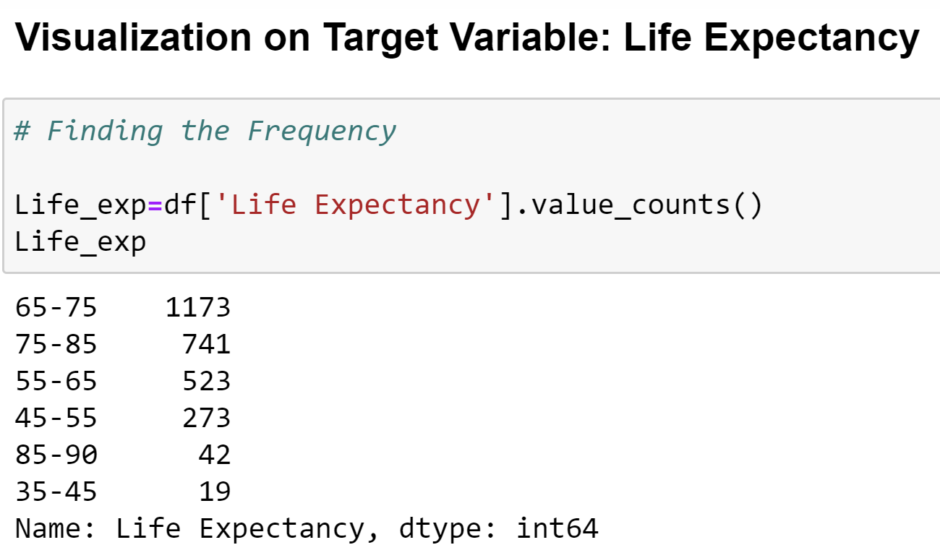
Univariate Analysis
- Variable Life Expectancy

Slide 17
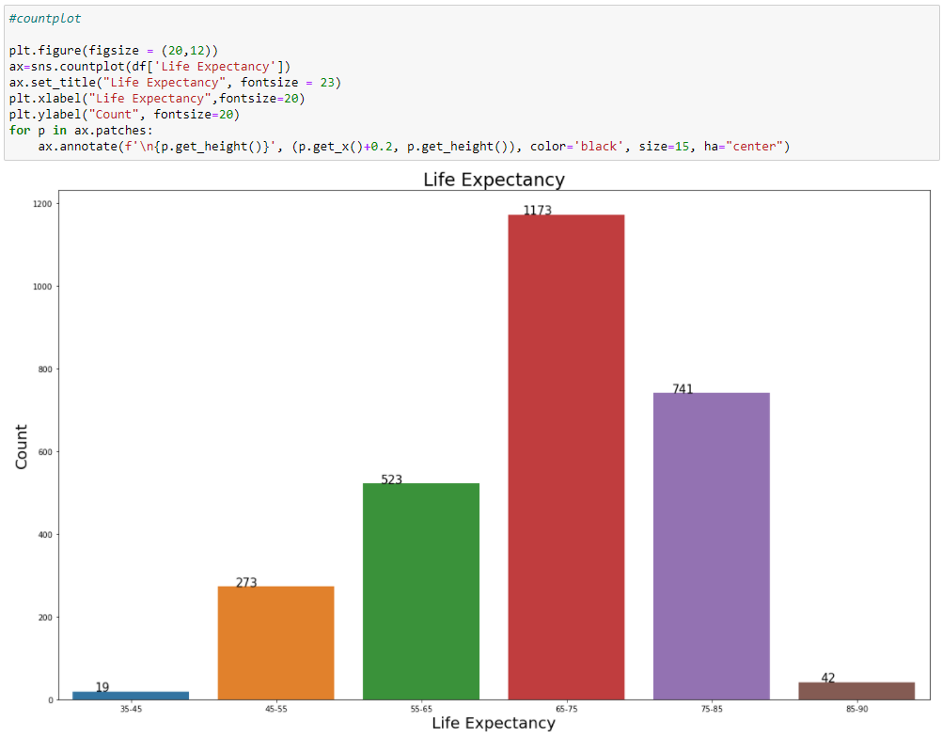
From this analysis, we understand that the range of global life expectancy is between 65-75

Slide 18
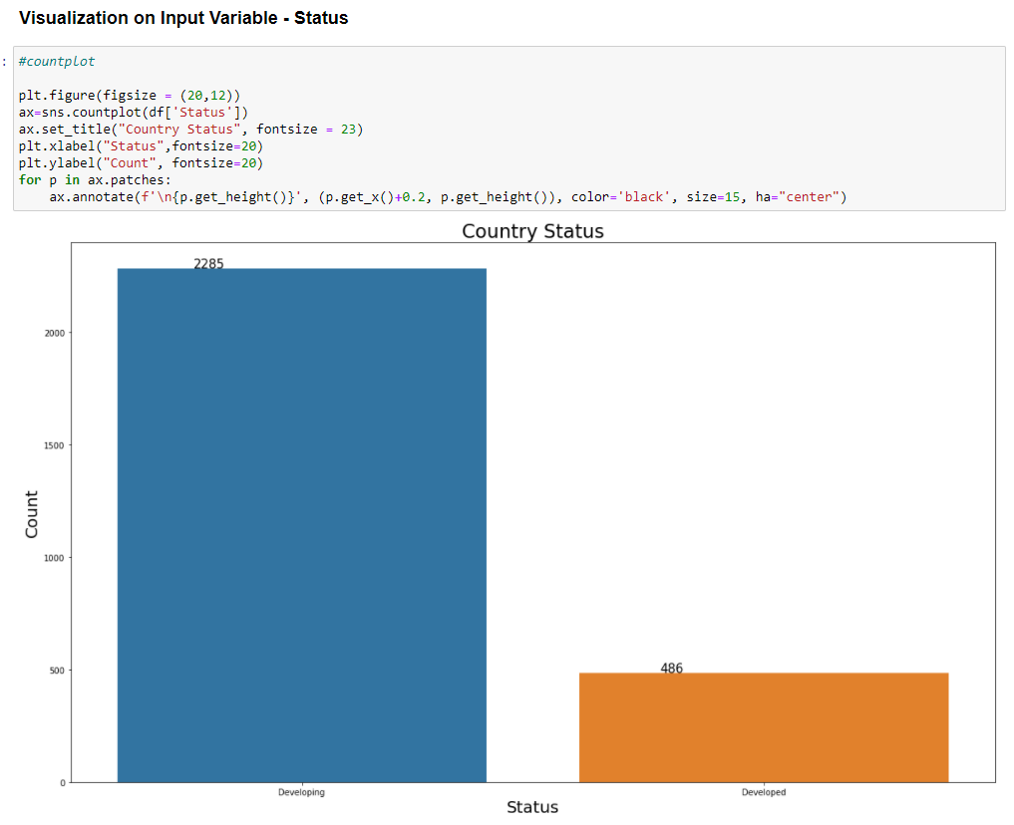
Univariate Analysis- Variable Status
We see that most countries fall under developing country status.

Slide 19
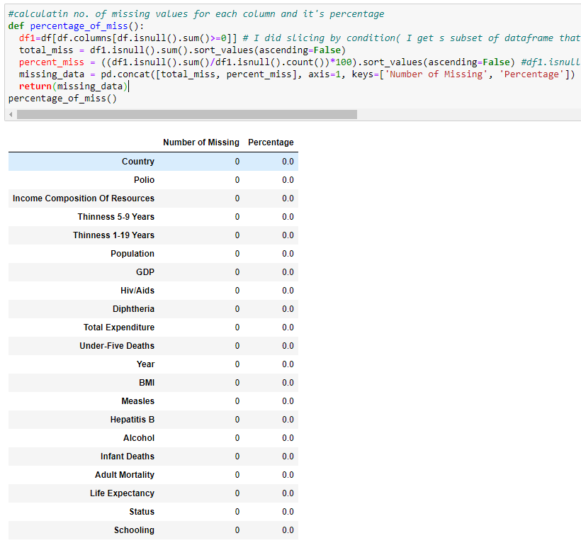

Slide 20
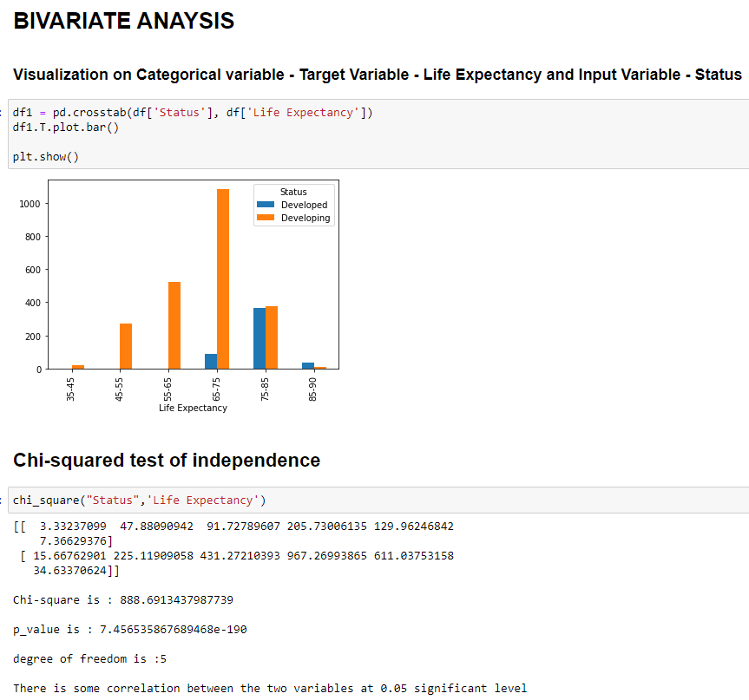

Slide 21
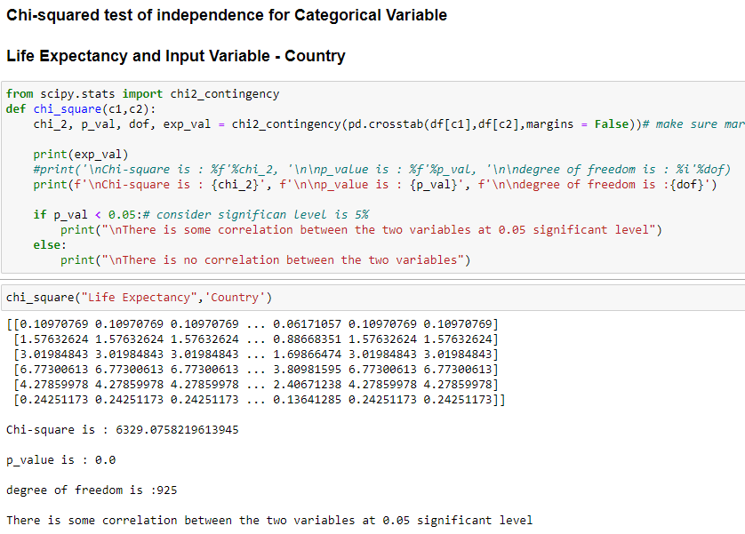

Slide 22
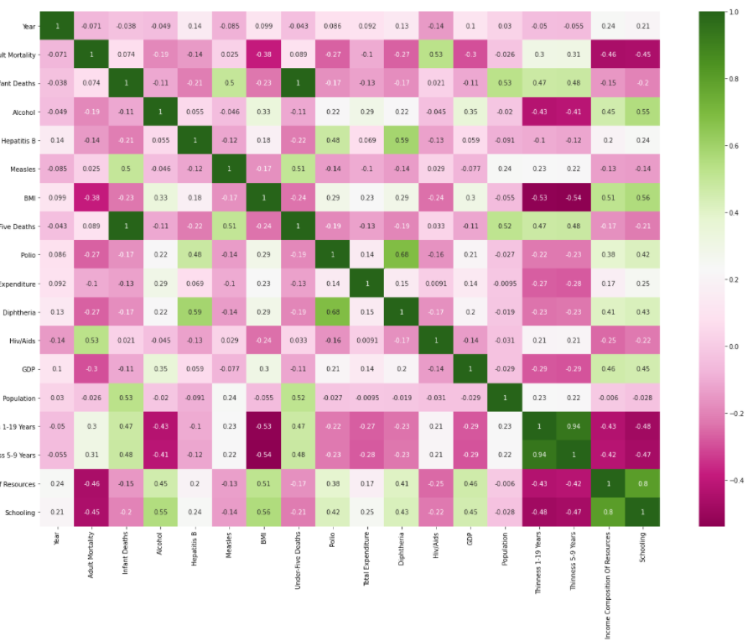

Slide 23
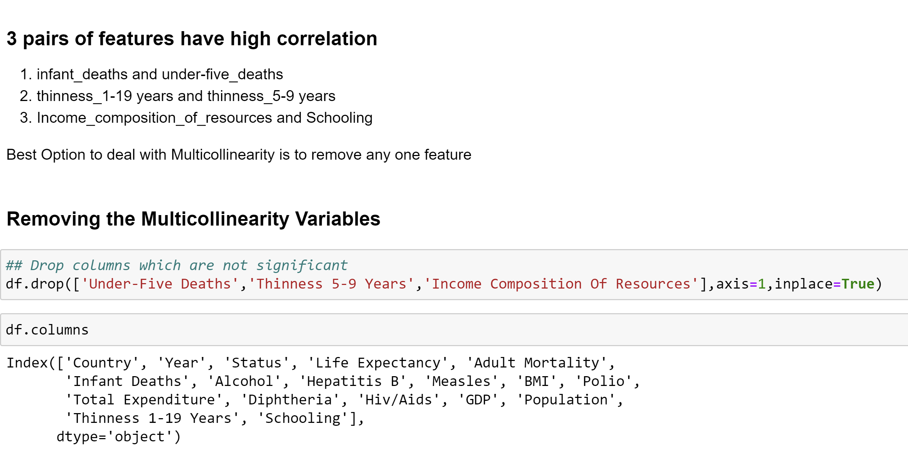
Some Insights on the heatmap:
1. Adult_mortality has negative relation with Schooling, Income_composition_of_resources and positive relation with HIV/AIDS.
2. Schooling and Alcohol have some positive relationship.

Slide 24
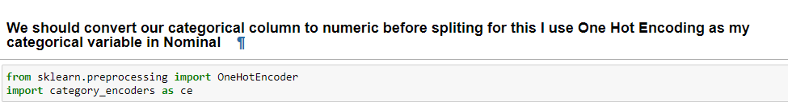
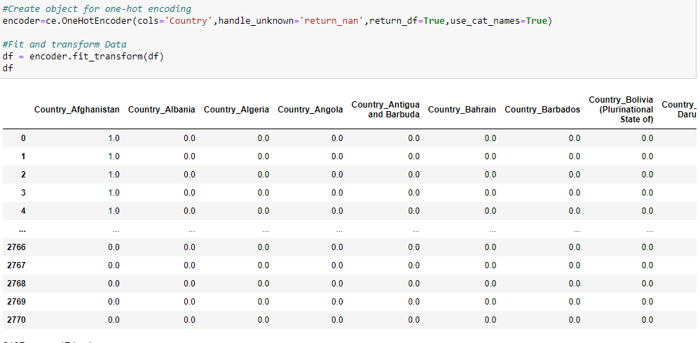
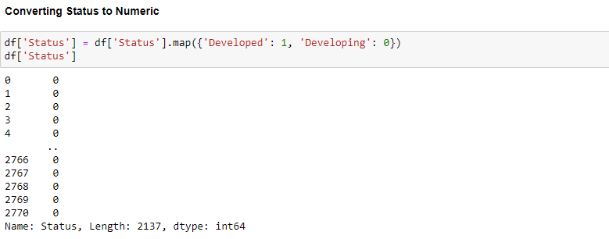

Slide 25
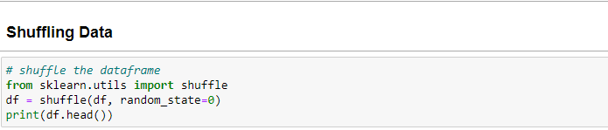
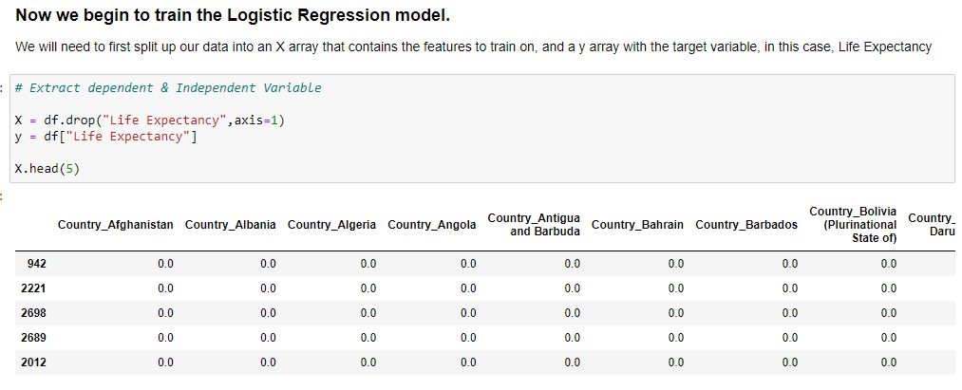

Slide 26
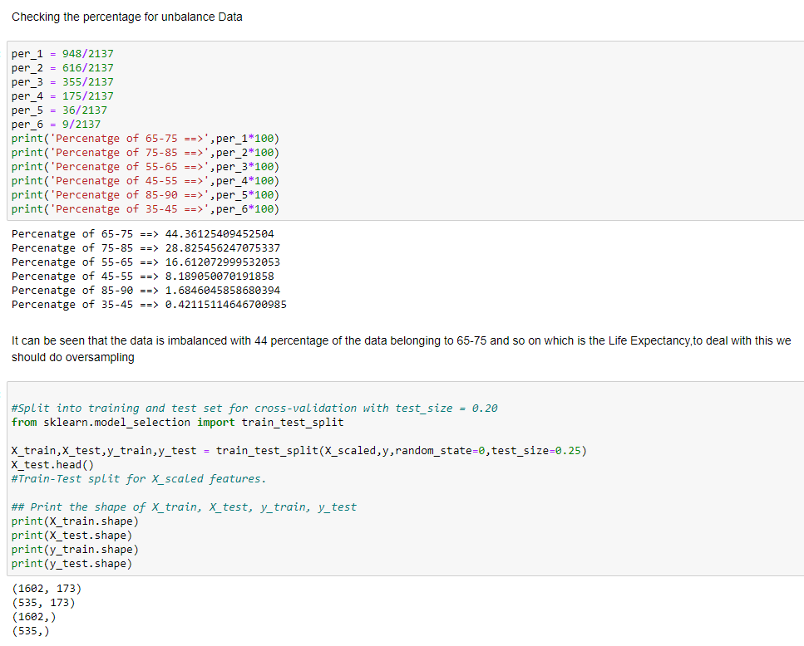

Slide 27
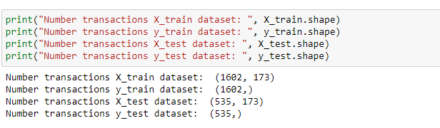
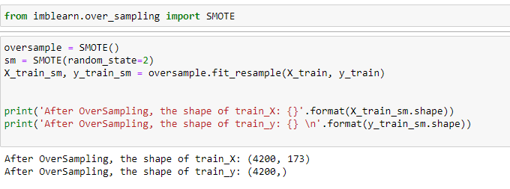
I will be using SMOT to do oversampling to treat the imbalance in my dataset
Before
After

Slide 28
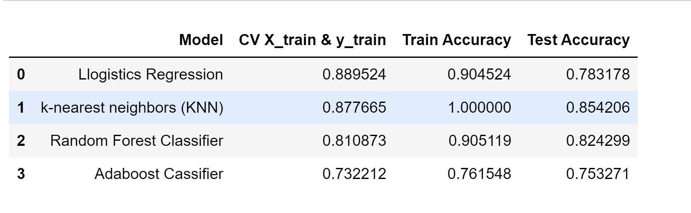
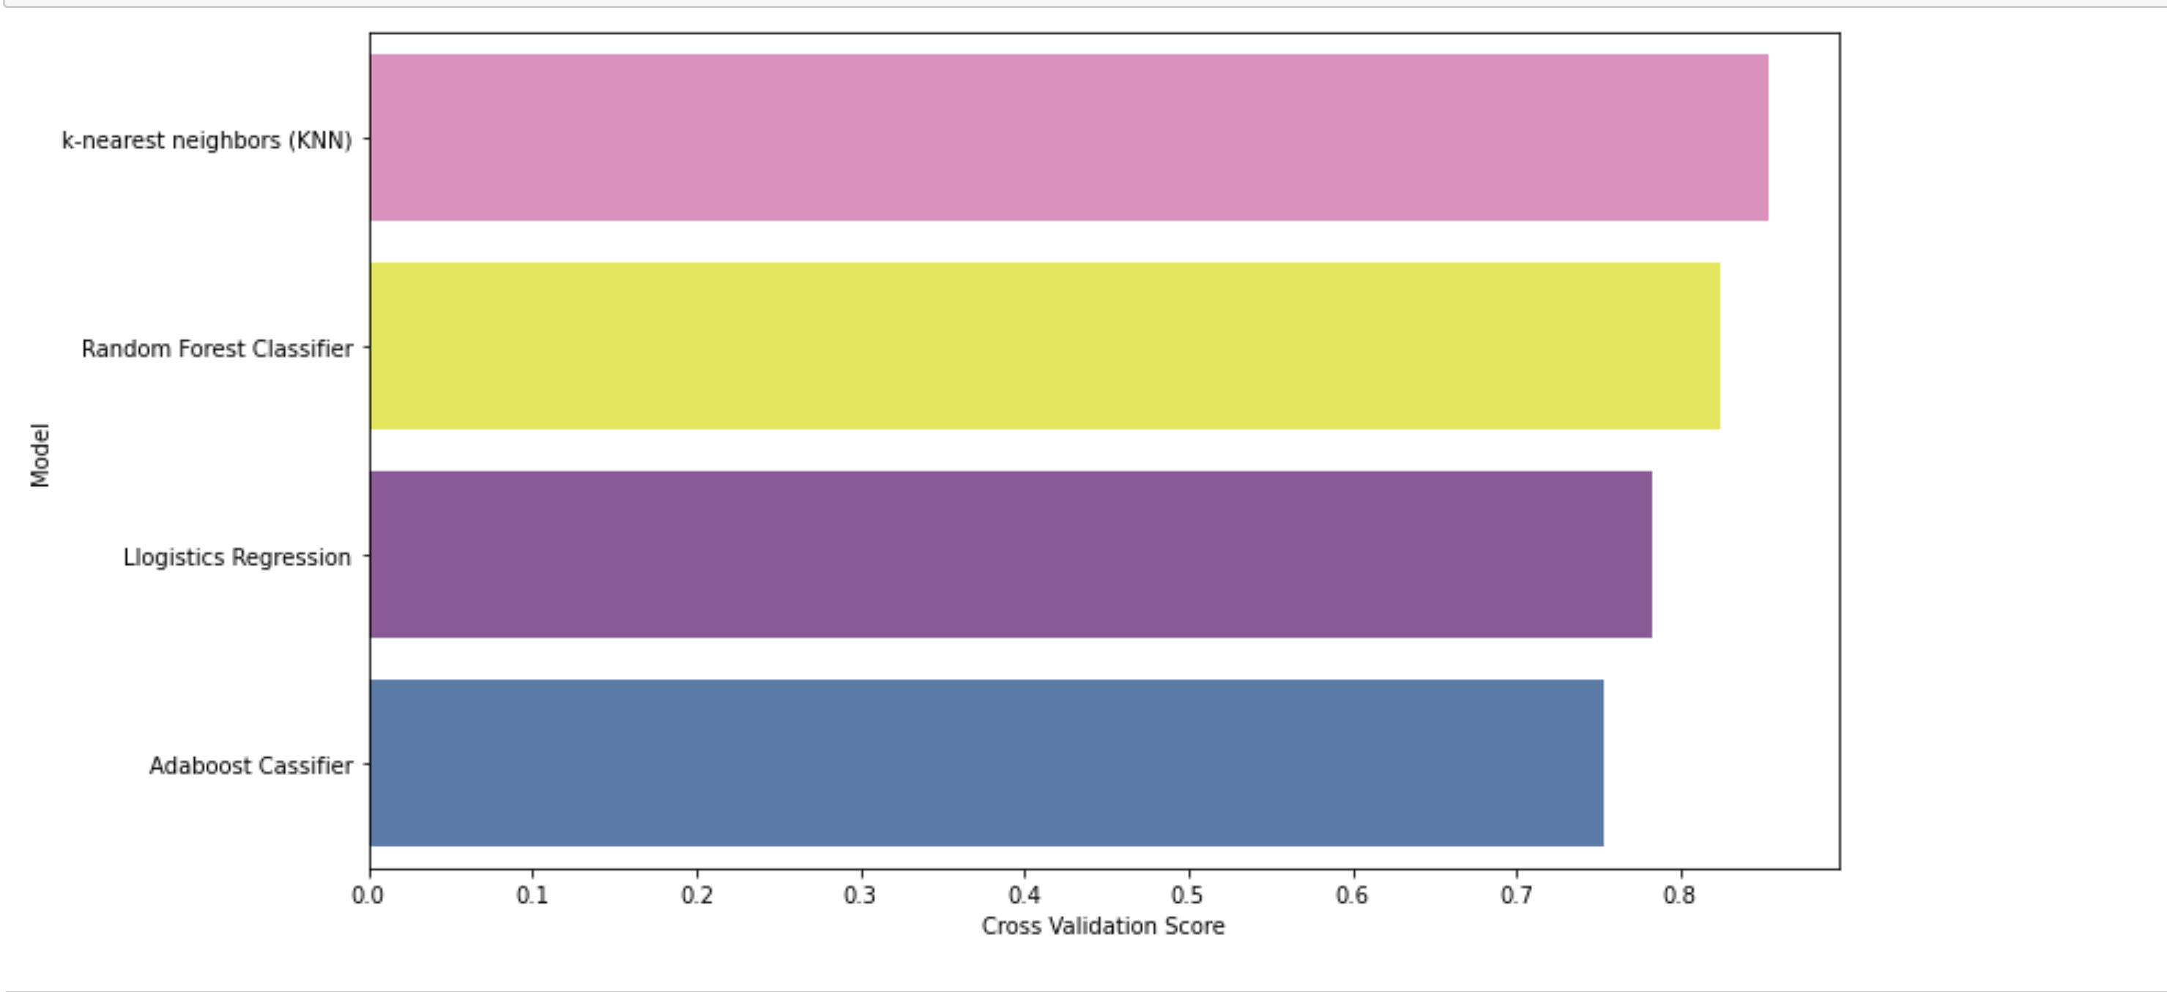
Modelling /Predicting target variable – Life Expectancy
On comparing different models we see that KNN is well suited with test accuracy of 85% and could be a good fit for real world too.

Slide 29
Conclusion
The highest average global life expectancy is between the range 65-75
With the increase in the years, life expectancy has improved.
Schooling has a positive relation with the life expectancy
Immunization for diseases like Polio, Diphtheria and Hepatitis B has strong relation to life expectancy
Adult Mortality and infant mortality does not increase the Life expectancy.
Alcohol consumption is most likely effecting life expectancy in developing countries having inverse relation.
Income composition of resources too has a positive relation, hence life expectancy is higher in developed countries as their income composition and GDP is higher.
On comparing different models we see that KNN is well suited with test accuracy of 85% and could be a good fit for real world too.

Slide 30
Recommendations
Developing countries must focus more on immunization - Polio, Diphtheria and Hepatitis B
Schooling has a positive impact of life expectancy and developing countries must focus on this area. Same applies to GDP too.
The life expectancy is more or less the same for developed countries. Whereas in developing countries the life expectancy deteriorates as alcohol consumption increases and government must put restrictions on its usage.

Slide 31
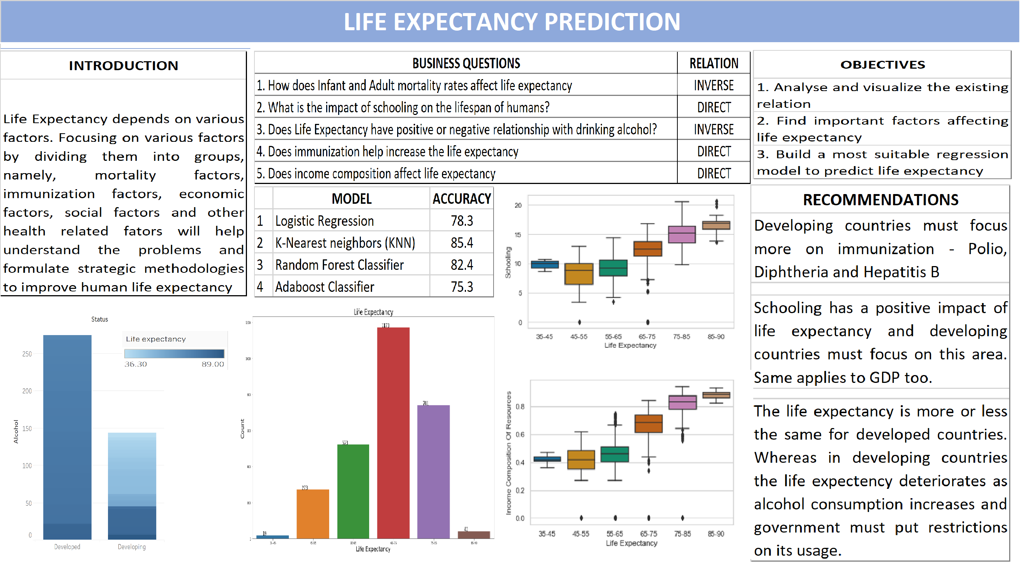

Slide 32
THANK YOU

